Slide 1

ITRO TICKETING SERVICE
RAMS’ CORNER:
A PROJECT BY:
01

Slide 2


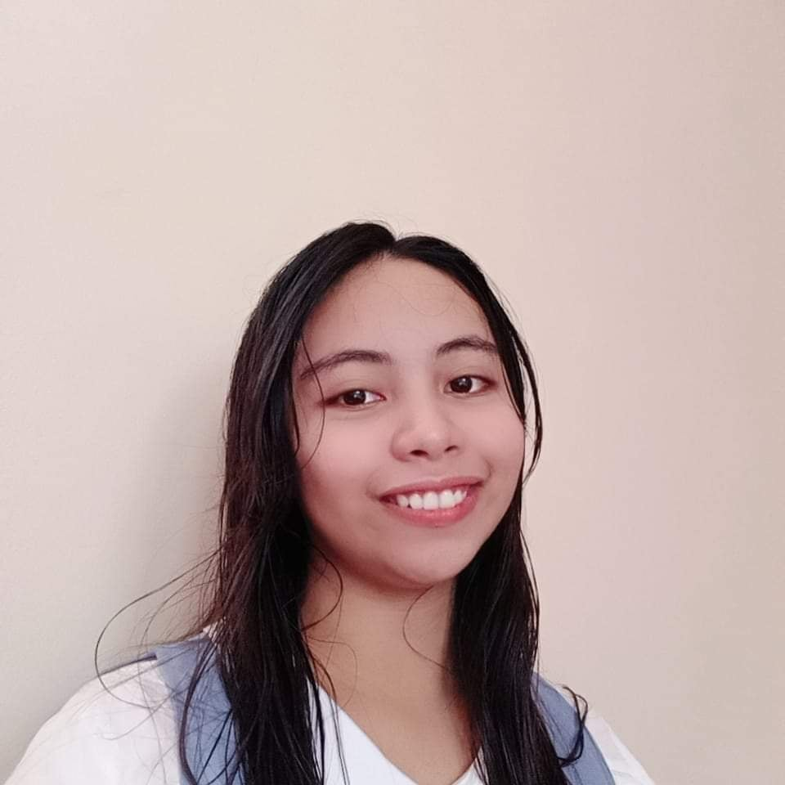
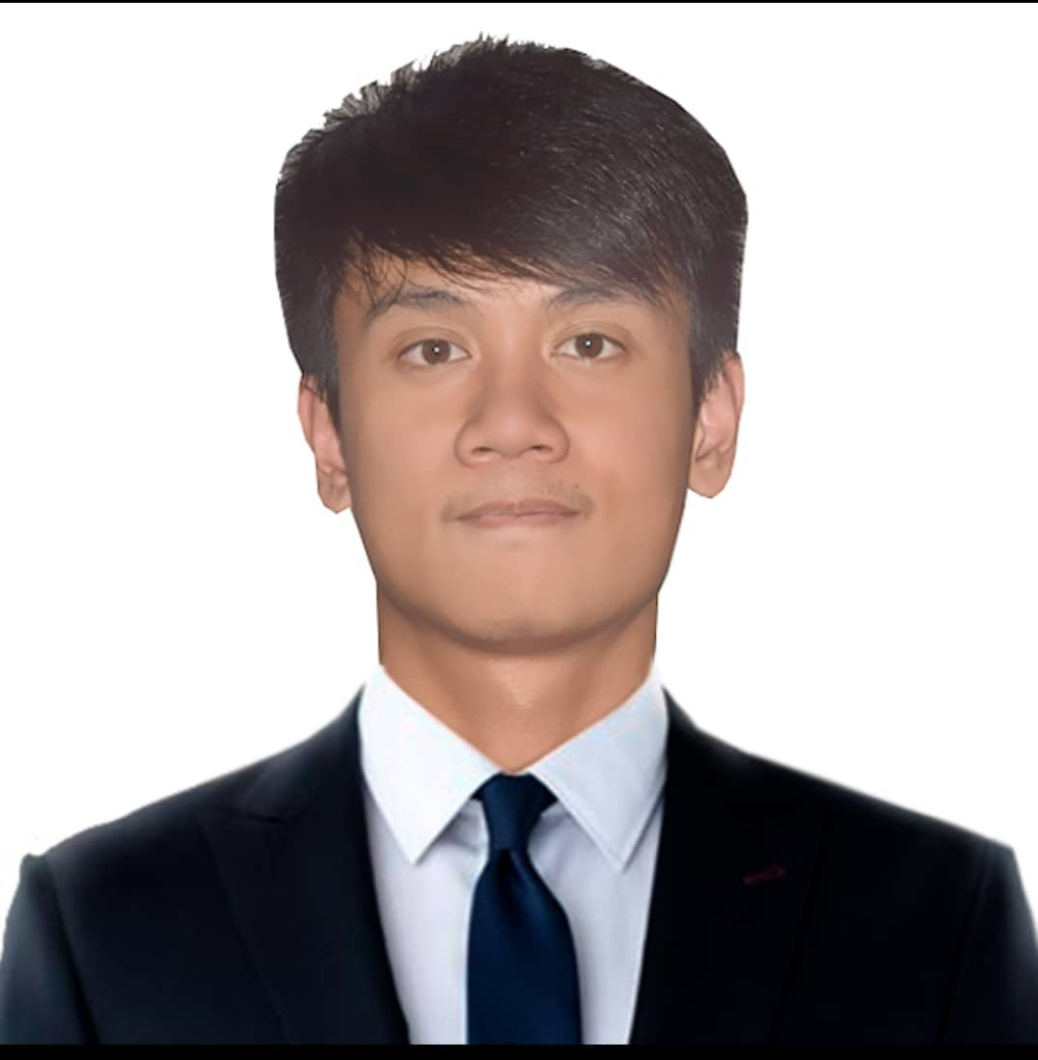
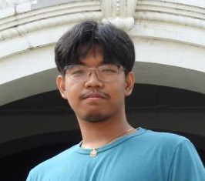
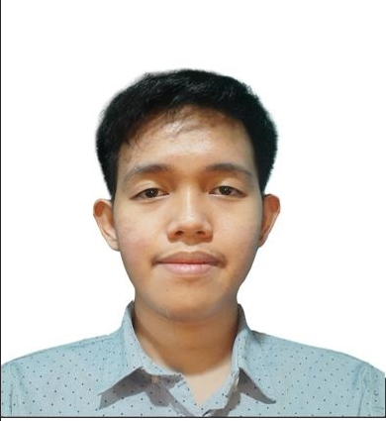
Team Mem
Title or Position
TEAM MEMBERS:
Ruth
Alvin C. Limpin
Project Adviser
Kieyl Ponce
Product Owner
Ruth Morallos
Team Leader
Scrum Master
Vincent Nacor
Project Documentation
Allan Vincent Nefalar
Scrum Member
Patrick Cortez
Project Documentation
Elaborate on what you want to discuss.

Slide 3
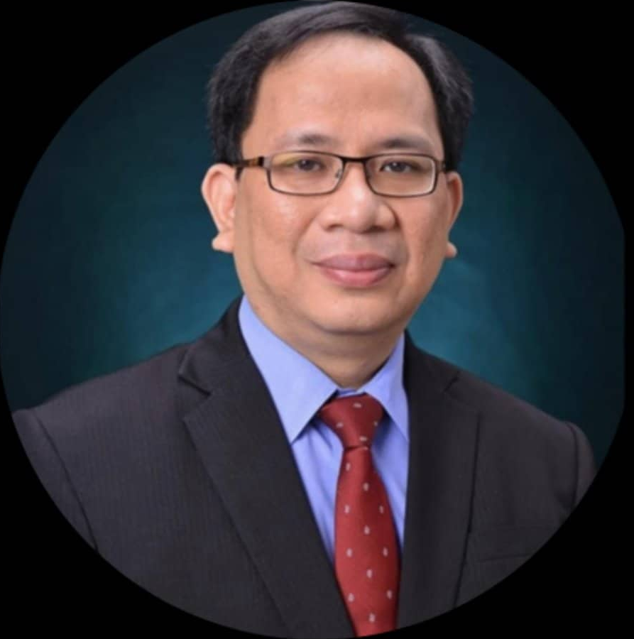

CLIENT: APC-ITRO
Head: Mr Jose Castillo
Task: Handles IT-related issues in APC

Slide 4
Improvements Matrix/Revisions

Slide 5
Check all the spellings written in the system (ex. “infrastracture”)

Slide 6
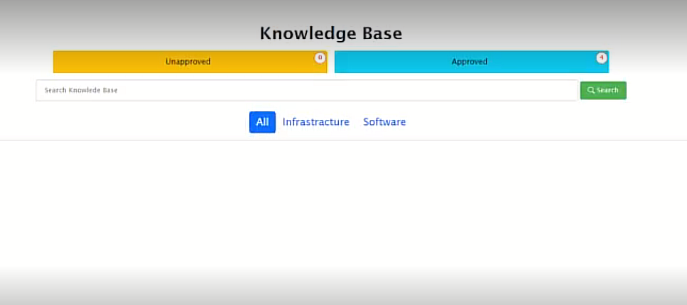
Before:

Slide 7
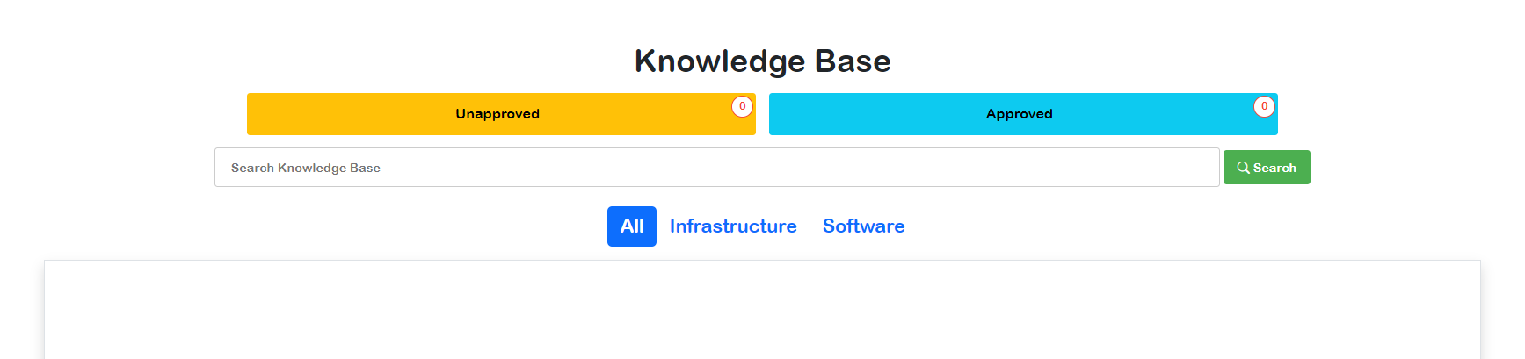
After:

Slide 8
Change the most viewed ticket to most reported issue

Slide 9
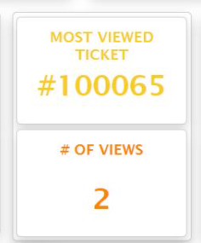
Before:

Slide 10
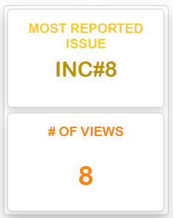
After:

Slide 11
Apply tooltip so that users can have further understanding

Slide 12
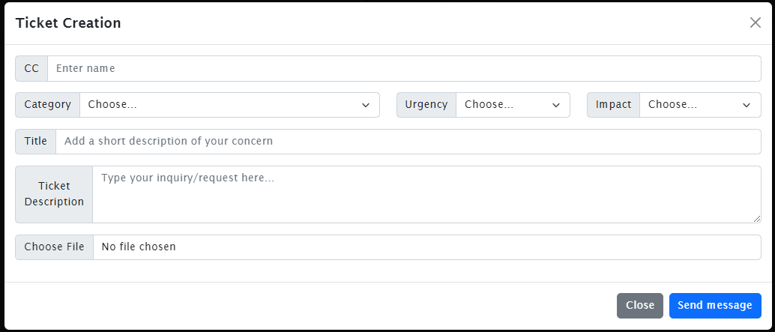
Before:

Slide 13
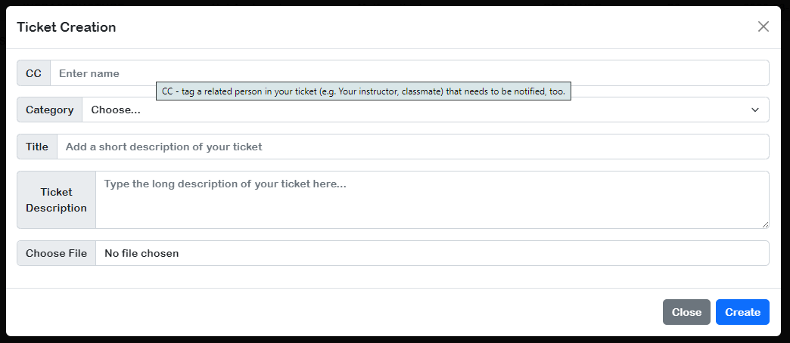
After:

Slide 14
Apply data types on ERD and make data dictionary

Slide 15
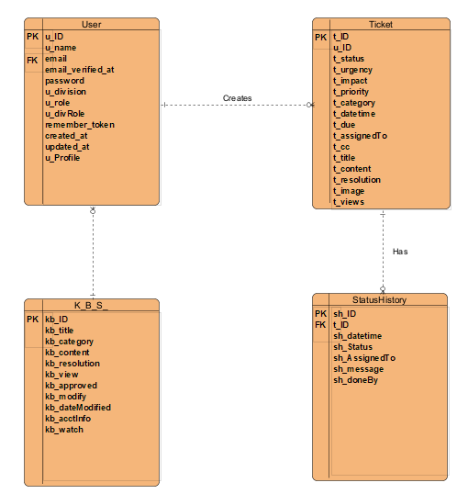
Before:

Slide 16
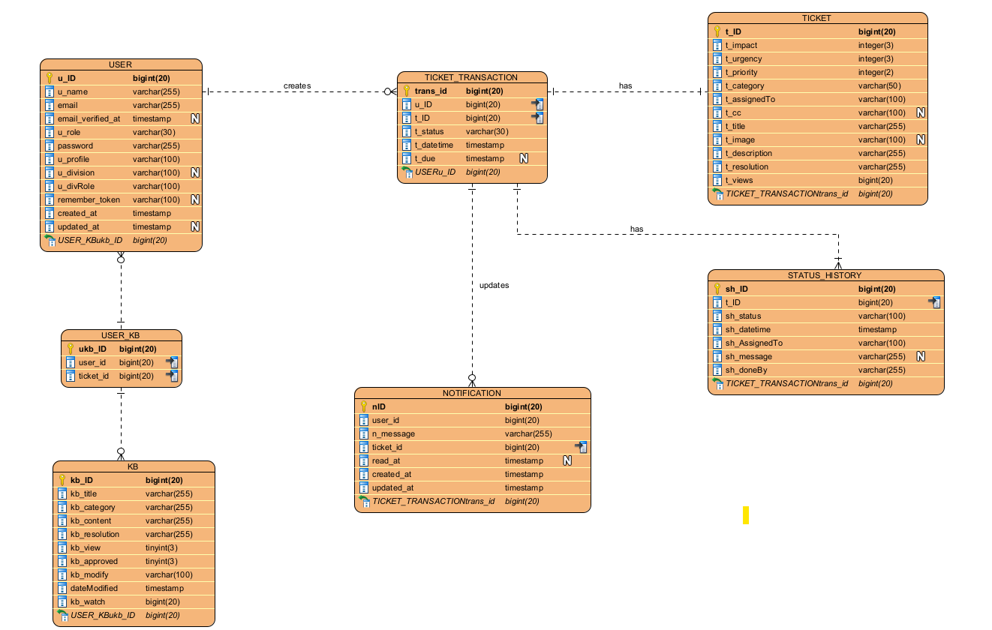
After:

Slide 17
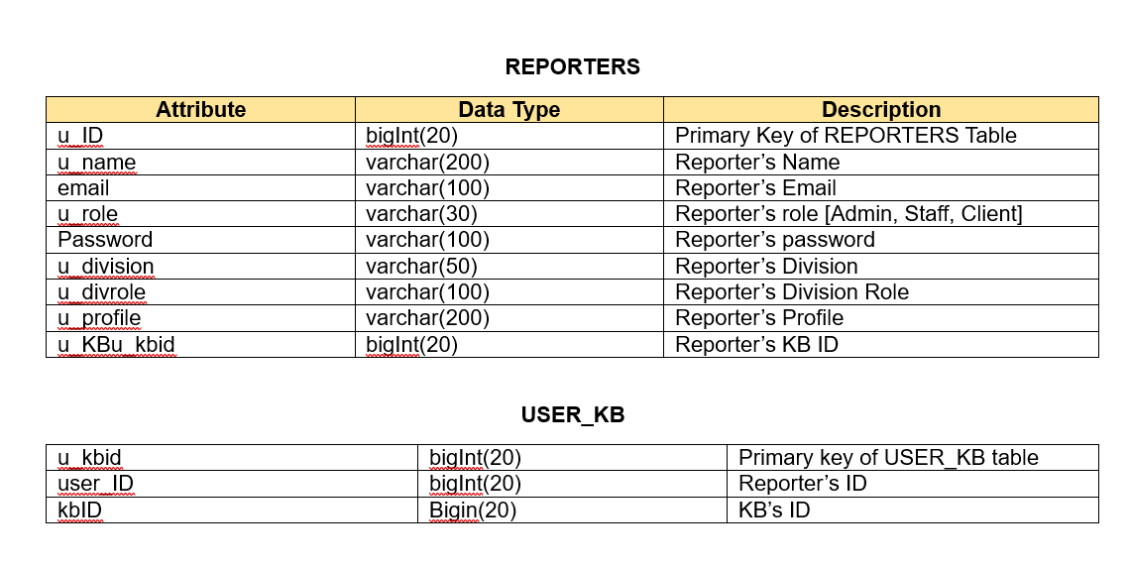
After:

Slide 18
In ERD, change t_content to t_description

Slide 19
Before:

Slide 20
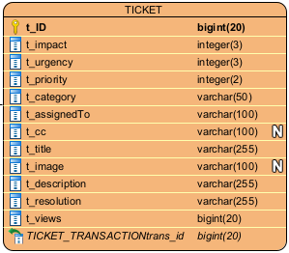
After:

Slide 21
Add notification to avoid missing out tickets

Slide 22
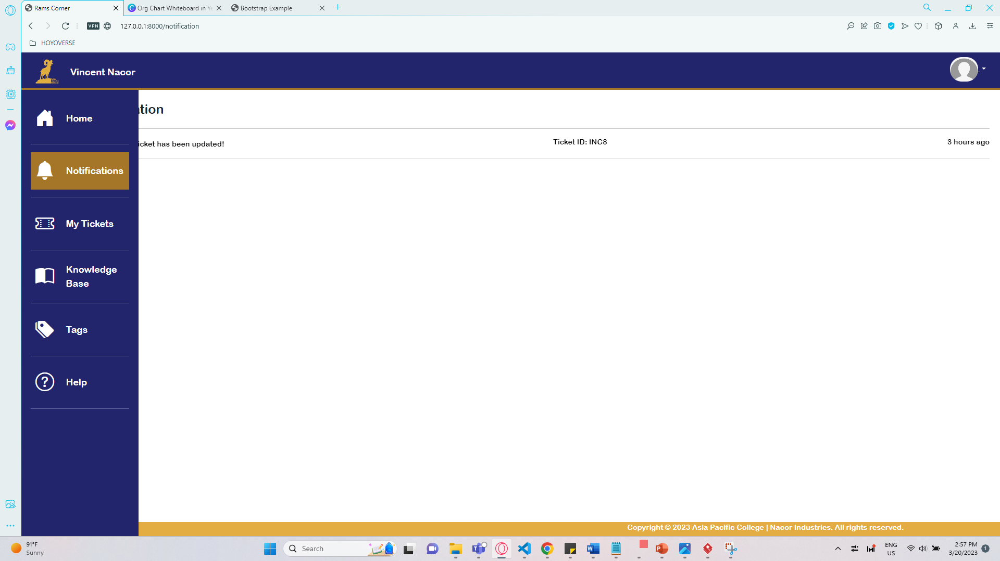
Before:

Slide 23
After:

Slide 24
New tickets are supposed to appear on top

Slide 25
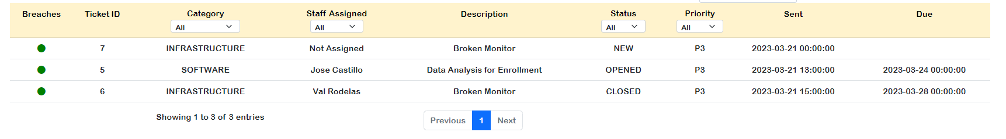
Before:

Slide 26
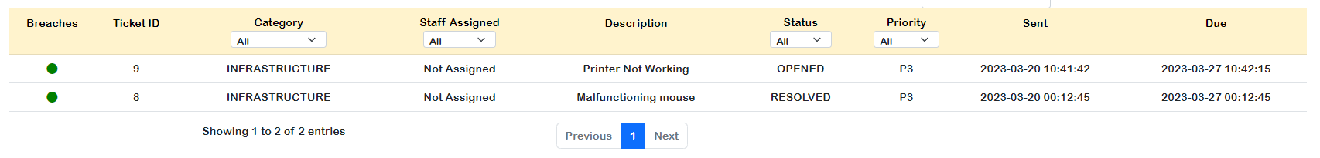
After:

Slide 27
Visibility of the status

Slide 28
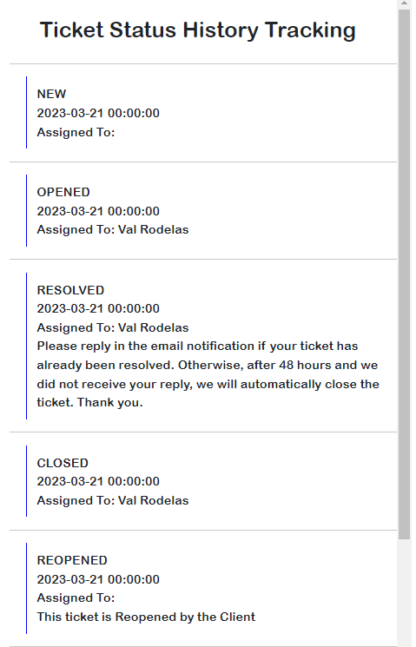
Before:

Slide 29
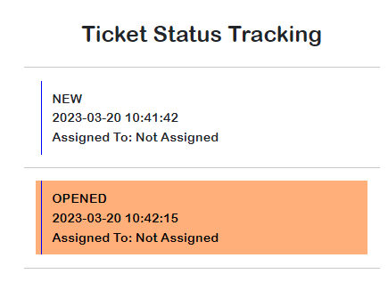
After:

Slide 30
Terminologies doesn’t match the overall functionality

Slide 31
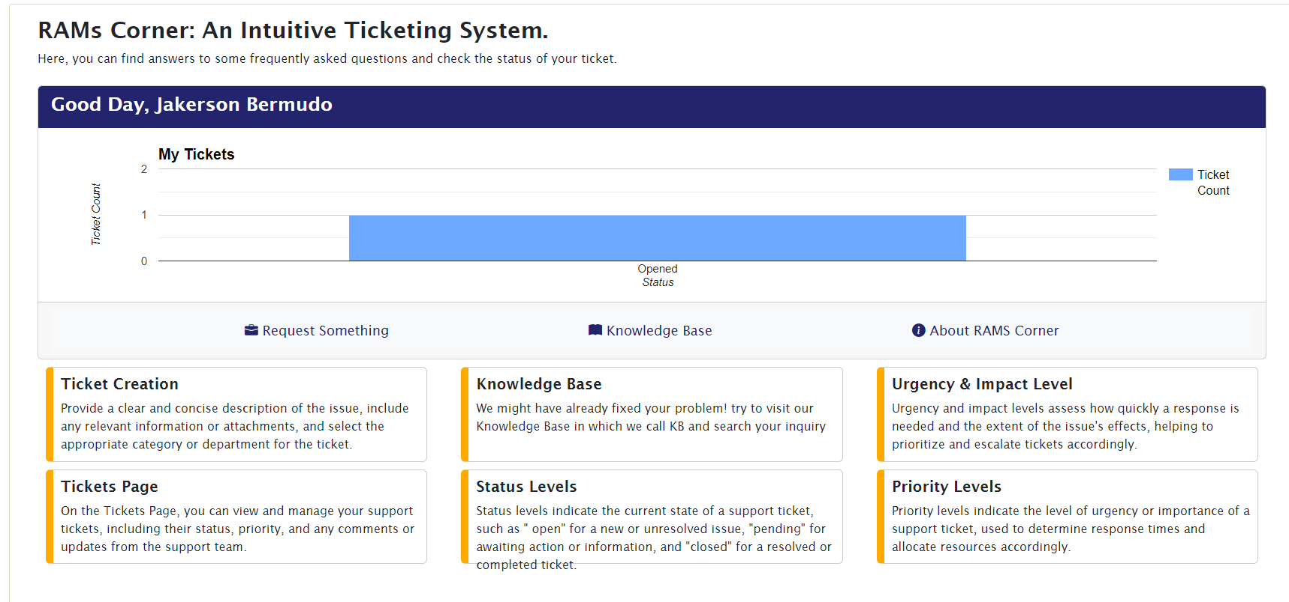
Before:

Slide 32
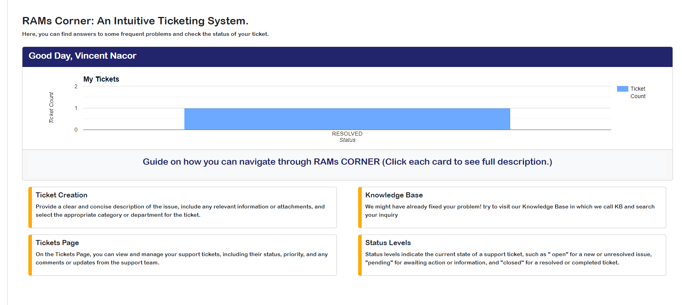
After:

Slide 33
Some of the terminologies are hard to understand for non-technical people

Slide 34
Before:

Slide 35
After:

Slide 36
THANK YOU!

